Slide 1


NEXT GEN EMPLOYABILITY PROGRAM
CREATING A FUTURE-READY WORKFORCE
Student Name :
HEMANTH S
Student ID :
College Name :
STU678f70ce9e2801737453774
Global Academy of Technology

Slide 2
CAPSTONE PROJECT SHOWCASE
Project Title
Recipe Sharing Platform with React and Express js Framework
Abstract | Problem Statement | Project Overview | Proposed Solution | Technology Used | Modelling & Results | Conclusion | Q&A

Slide 3
Abstract
1
The Recipe Sharing Platform is an innovative web application.
2
Users can create, share, and manage recipes with real-time updates.
3
It includes user authentication, document management, and live collaboration.
4
The platform enhances user engagement and interaction.

Slide 4


Problem Statement
Lack of a centralized platform for storing and sharing recipes hinders user collaboration. Existing solutions do not support real-time updates or interactive modifications. This results in inefficient organization and limited user engagement.

Slide 5

Project Overview
A web-based Recipe Sharing Platform with an intuitive UI.
Provides user authentication, recipe management, and real-time updates.
Users can interact, share, and collaborate efficiently on recipes.

Slide 6
Proposed Solution
MongoDB: A NoSQL database used for storing user data and recipes efficiently.
Express.js: A lightweight Node.js framework for building the backend API and handling requests.
React.js: A frontend library for creating a dynamic and interactive user interface.
Node.js: A JavaScript runtime environment that enables server-side logic and API execution.

Slide 7
Technology used
React.js
Node.js
MongoDB
Express.js

Slide 8
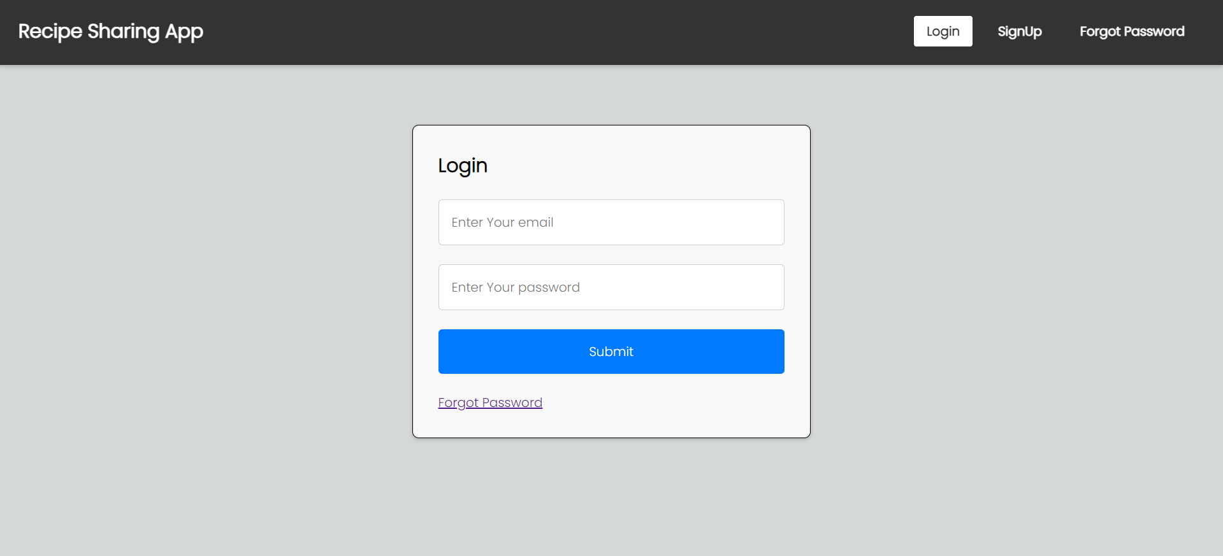
Modelling & Result

Slide 9
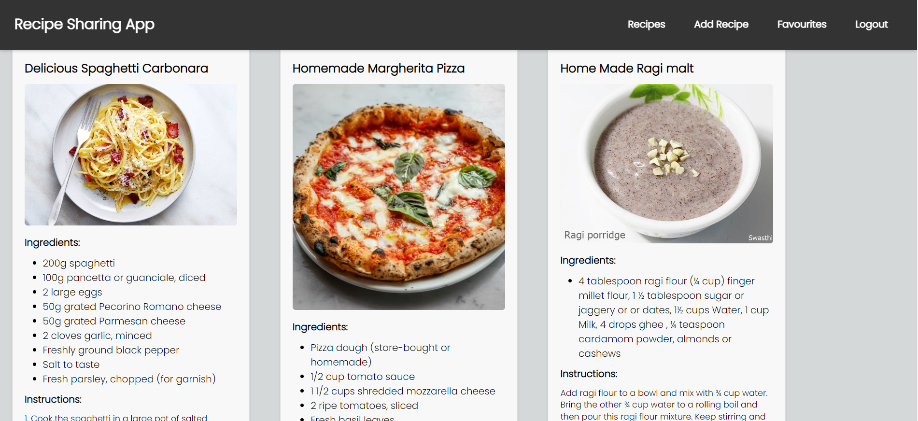
Modelling & Result

Slide 10

Conclusion
The platform enhances recipe sharing and collaboration by allowing users to create, manage, and share recipes seamlessly.
It ensures real-time synchronization, enabling multiple users to access and update recipes instantly without conflicts.
Secure authentication mechanisms and an intuitive user interface provide a safe and user-friendly experience.

Slide 11


Notes:
Thank You !!

